Slide 1

STUDENT DETAILS
Name : R. Lakshmi Kalyani
ID : 22JN1A4311
Collage : KIET (women)
Domain : ARTIFICAL INTELLIGENCE (CSE-AI)
State : Andhra Pradesh (A.P)
District : Kakinada
E-mail : lakshmikalyanirasamsetti@gmail.com
internship start date
: 3/6/2024
internship end date
: 15/7/2024

Slide 2
PROJECT TITLE / PROBLEM STATEMENT
EMPLOYEE BURNOUT
PREDICTION
USING LINEAR REGRESSION
employee burnout levels using linear regression. Employee burnout is a state of physical, emotional, and mental exhaustion caused by prolonged stress. Predicting burnout can help in implementing timely interventions to improve employee well-being and productivity.

Slide 3
AGENDA
EMPLOYEE BURNOUT PREDICTION
DATA.HEAD( )
DATA.TAIL( )
DATA.DESCRISE( )
DATA.COLUMS.TOLIST( )
DATA.NUNIQUE ( )
DATA.INFO( )
DATA.ISNULL( ).SUM( ).VALUES.SUM( )
DATA CORRENUMERIC ONLY=TRUE([‘BURN RATE][:-1]

Slide 4
AGENDA (2ND PART)
SNS.PAIRPLOT(DATA)PLT.SHOW( )
PLT.SHOW( )
DATA=DATA.DROPNA( )
DATA.SHAPE
DATA.DTYPES
DATA=DATA.DROP(‘EMPLOYEE ID AXIS=1)
NUMERIC _DATA= DATA.SELECT
DTYPES(INCLUDE=[‘NUMBER’]CORRELATION=NUMERIC DATA.CORR()[‘BURN RATE’](CORRECTION)
X_RRAIN
Y_TRAIN

Slide 5

PROJECT OVERVIEW
EMPLOYEE BURNOUT IS A STATE OF EMOTIONAL, PHYSICAL, AND MENTAL EXHAUSTION CAUSED BY PROLONGED OR EXCESSIVE STRESS. THIS CONDITION CAN HAVE DETRIMENTAL EFFCTS ON INDIVIDAL WELL-BEING AND ORGANIZATION PRODUCTIVITY
EMOTIONAL EXHAUSTION:
Feeling emotionally drained, depleted and lacking in energy.
DEPRESONALIZATION:
Developing a cynical and detached attitude towards work.
REDUCED PERSONAL ACCOMPLISHMENT:
Experiencing feelings of inadequacy and failure in one’s work.
PHYSICAL SYMPTOMS:
headache, fatigue and sleep disturbances.

Slide 6
WHO ARE THE END USERS of this project?
EMPLOYEES
ORGANISATION
OWNERS

Slide 7
YOUR SOLUTION AND ITS VALUE PROPOSITION
change in behavior :
Increased absenteeism, decreased performance, or noticeable changes in attitude.
Mental Exhaustion :
Difficulty concentrating, forgetfulness, or reduced problem-solving ability.
Workload Management :
Ensure workloads are manageable and provide support during peak times.
Build a Supportive Community :
Foster a supportive and inclusive work environment where employees feel valued and connected.

Slide 8
How did you customize the project and make it your own
Workload:
Excessive work demands, long hours, and high pressure contribute significantly to burnout.
Community:
Poor workplace relationships, isolation, and lack of support can increase burnout risk.
Balance:
Poor balance between personal life and work responsibilities contributes significantly to burnout.
Health and Wellness:
Poor physical and mental health, often exacerbated by workplace stress, is both a cause and effect of burnout.

Slide 9
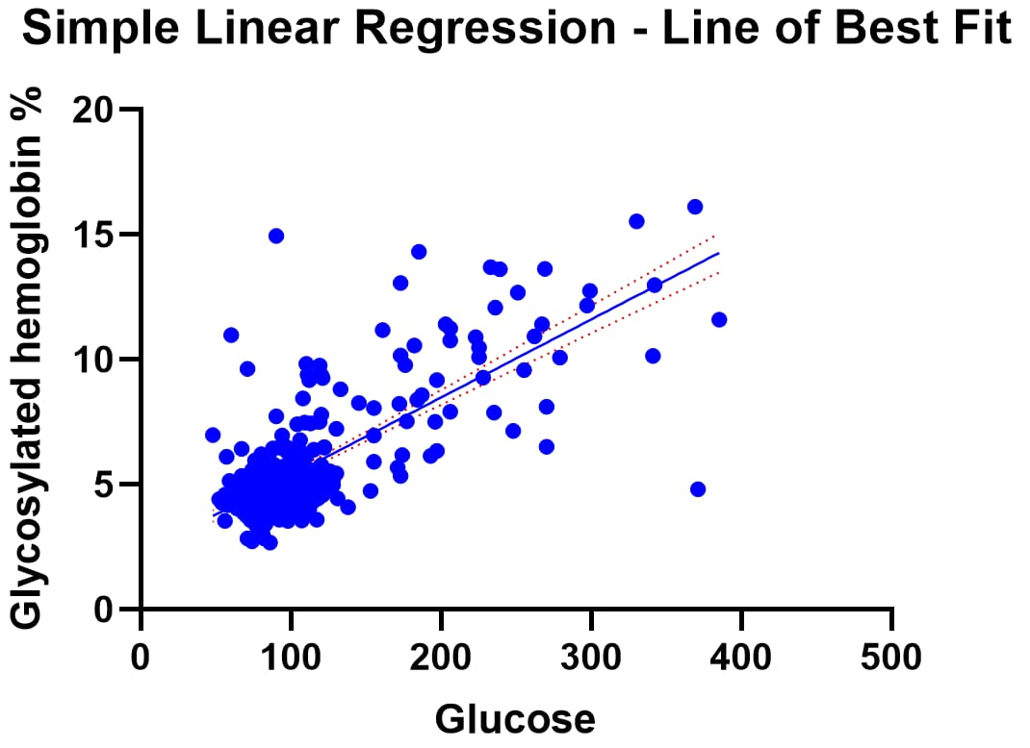
MODELLING
LINEAR REGRESSION
linear regression is a powerful statistical
technique to model the relationship
between a dependent variable And one
or more independent variables it’s
widely applied to understand and
Predict outcomes in various
Fields. Including economics
finance and healthcare

Slide 10
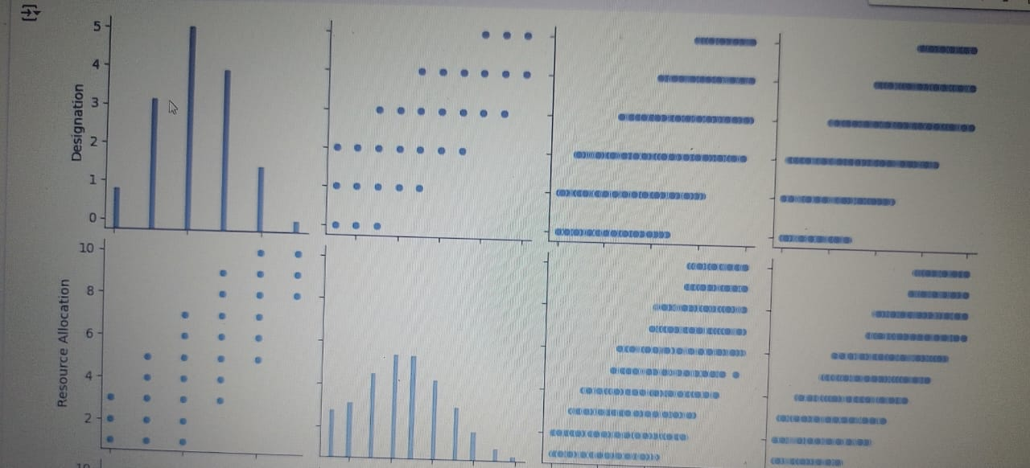
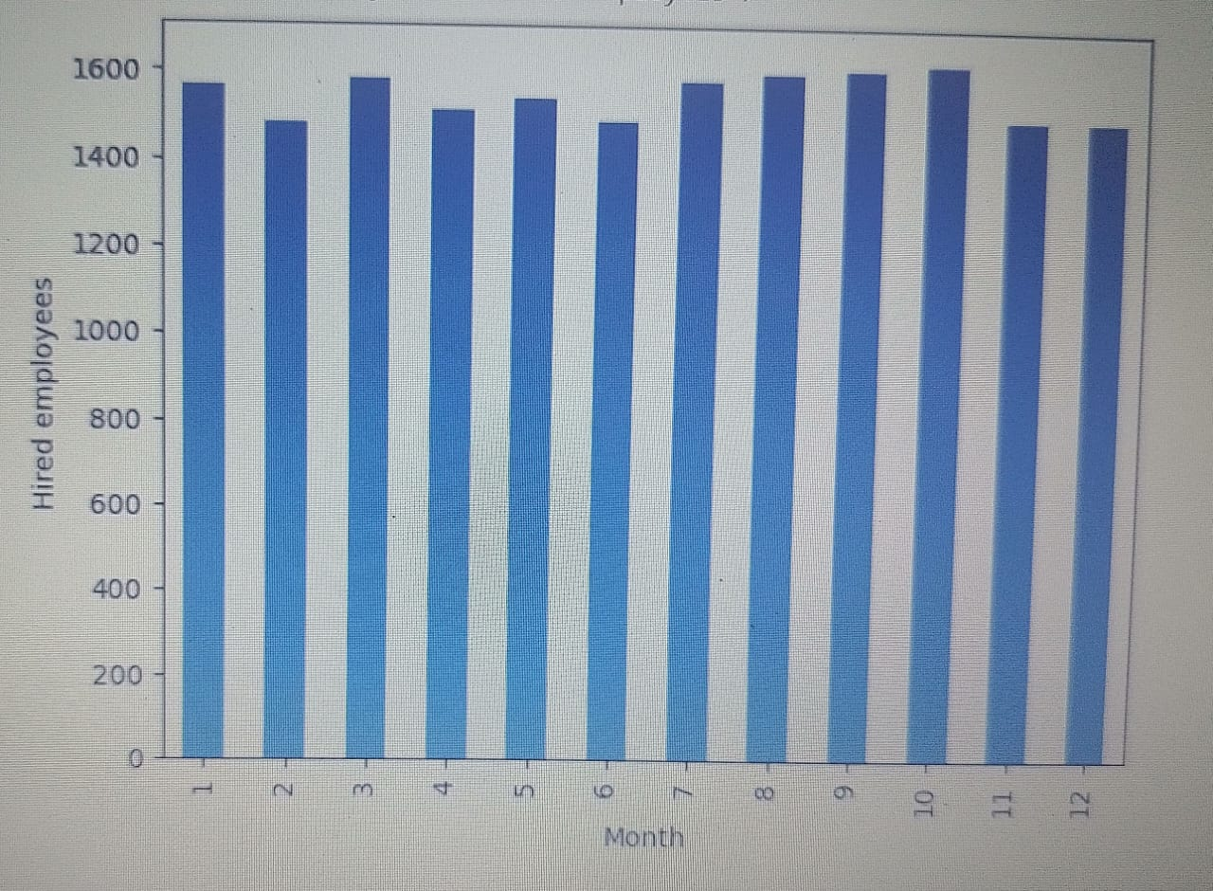
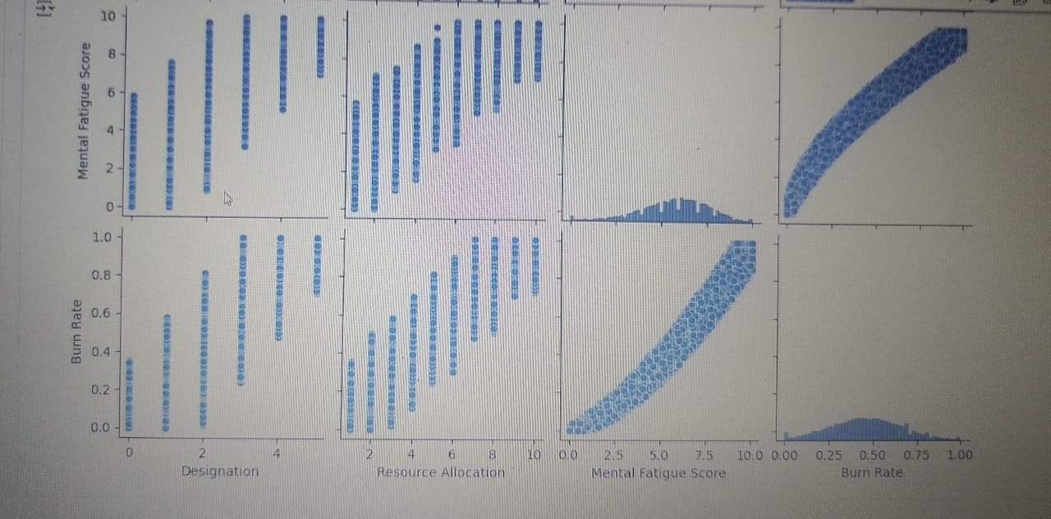
RESULTS

Slide 11
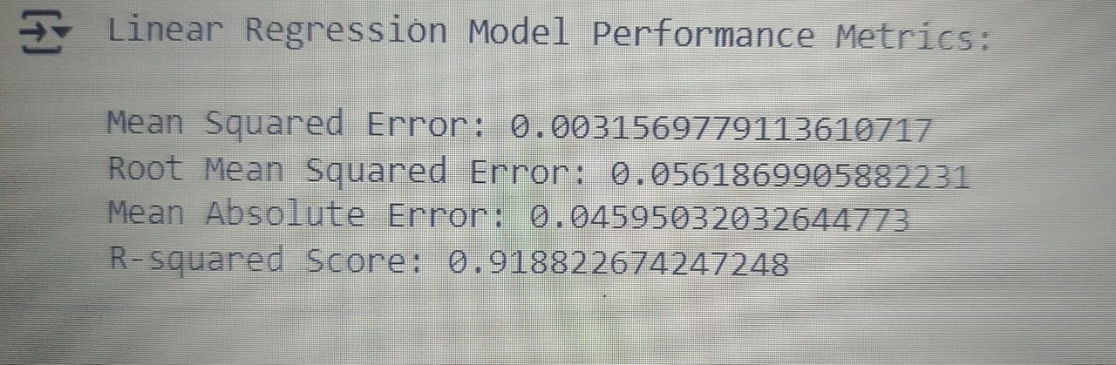
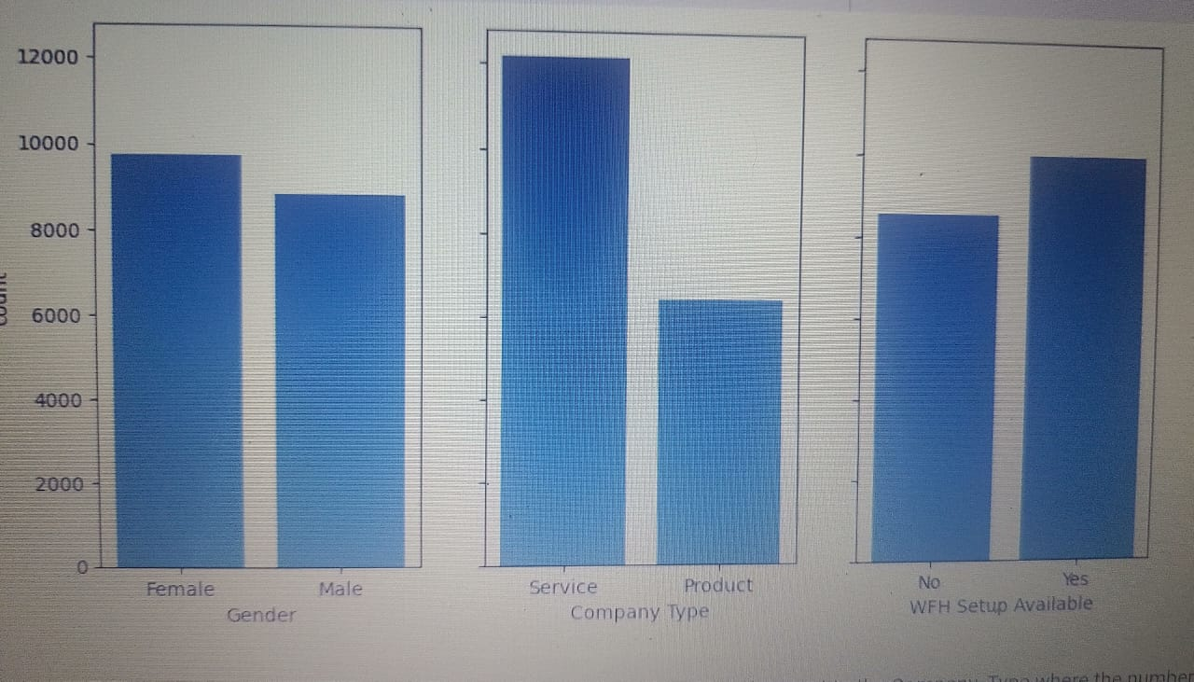
RESULTS

Slide 12
Links
https://www.linkedin.com/in/lakshmi-kalyani-rasamsetti-404920316
Linked link
https://skills.yourlearning.ibm.com/activity/PLAN-3E9AB40DB051
Learning plan link
https://colab.research.google.com/drive/1ABVIficcZyuNAO9XJSMcyTcAdc828OSG?usp=sharing
Project of GitHub link
https://skills.yourlearning.ibm.com/activity/PLAN-04138CD348A7
Orientation certificate link

